Slide 1

Cash Management: Revenue Deposits

Slide 2
Purpose
To provide guidance for secure receiving, receipting and processing of revenue by spending units and their employees
Increase knowledge of responsibilities of employee’s handling revenue.
Provide guidance to establishing procedures
Provide knowledge and understanding of the associated risks and help prevent fraud
Protect employees from inappropriate charges of mishandling funds.

Slide 3
What is Included in Cash Handling
•Dollar bills and coins
•Checks
•Money orders
•Cashier’s checks
Office of the Bursar

Slide 4
General Description
WV Code 12-2-2 requires all employees of the state to keep daily itemized record of revenue.
  All revenue shall be deposited within twenty-four business hours of any purpose whatsoever.
The following procedures will give employees a clear picture of what is expected.
  Which employee has access, what behavior is and is not acceptable, and how accurately to accept, handle, and safeguard Revenue.

Slide 5
Registration
All areas receiving revenue are to be approved by the Chief Financial Officer and must be registered with the Office of the Bursar.
Registration (Attachment A, next slide) shall include:
  Department name, responsible supervisor’s name, Chair/Director, Dean, Vice President, and description of nature of revenue received.
  Additionally, the supervisor, Chair/Director, Dean, and Vice President shall sign a certification that University and State procedures have been read and will be followed.

Slide 6
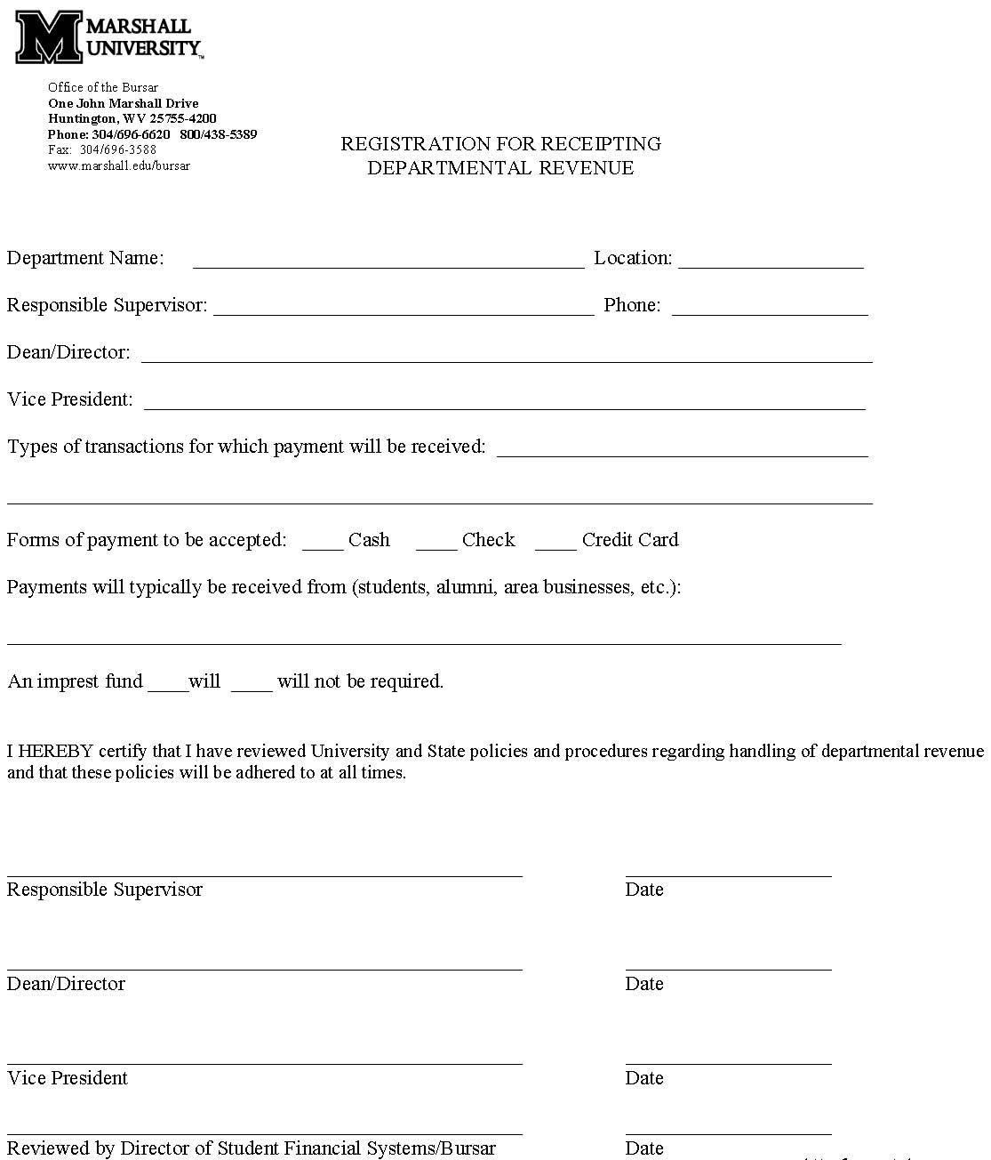
Attachment A

Slide 7
Safeguards/Internal Controls
Unless authorized by the Chief Financial Officer, an individual should not have sole responsibility for more than one of the following:
Collecting
Depositing
Segregation of Duties
Disbursement
Reconciliation

Slide 8
Safeguards/Internal Controls
Physical Security
  Once Revenue is received, it must be protected by storing in locked fireproof drawer, safe, or other secure place until revenue is deposited.
  The Departmental Unit must provide a secure area, out of sight of general public for processing and safeguarding Revenue.

Slide 9
Key Takeaways
Know WHO has access to cash and why they have access to cash
Individual Accountability
Cash Accountability
Know WHERE an asset is at all times
Process Accountability
Know WHAT has occurred from beginning to end of the process
Office of the Bursar

Slide 10
Counter/In Person Revenue
A pre-numbered receipt must be issued at the time funds are received (Attachment B, next slide).
Receipts must be pre-numbered regardless of whether the Departmental Unit has computer generated or handwritten receipts.
Every receipt issued must show the following:
  Amount received
  Date received
  Type of revenue (cash, check, money order)
  Name of the individual/company from whom received
  Purpose of the collection
  Departmental Unit name and employee name who prepared the receipt

Slide 11
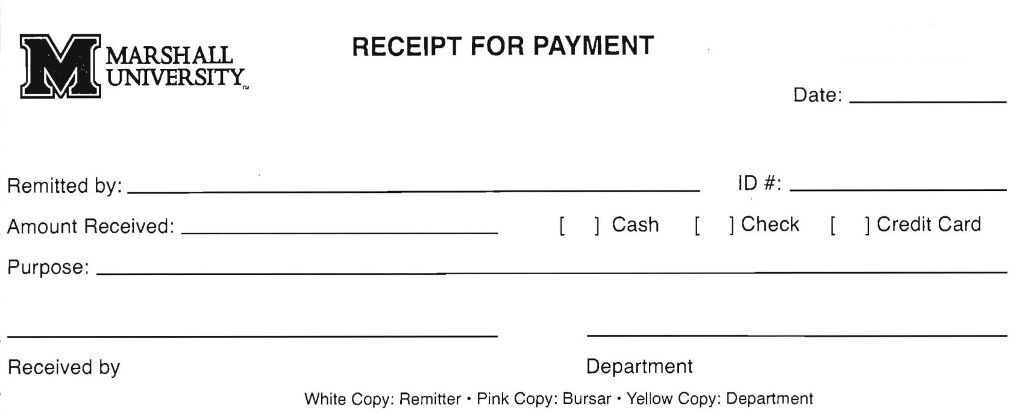
Attachment B

Slide 12
Counter/In Person Revenue
Pre-numbered receipt books are issued by the Office of the Bursar.
It is the Departmental Units responsibility to secure and retain the receipt books for audit purposes.
Receipts are prepared in triplicate:
  The original white copy is to be given to the individual from whom the revenue was received.
  The total cash and checks along with the pink copy of the pre-numbered receipt and calculator tape shall accompany and reconcile to the Departmental Revenue Deposit Ticket (Attachment C, next slide) submitted to the Office of the Bursar for processing.
  The Departmental yellow copy is not removable and should be retained in receipt book.

Slide 13
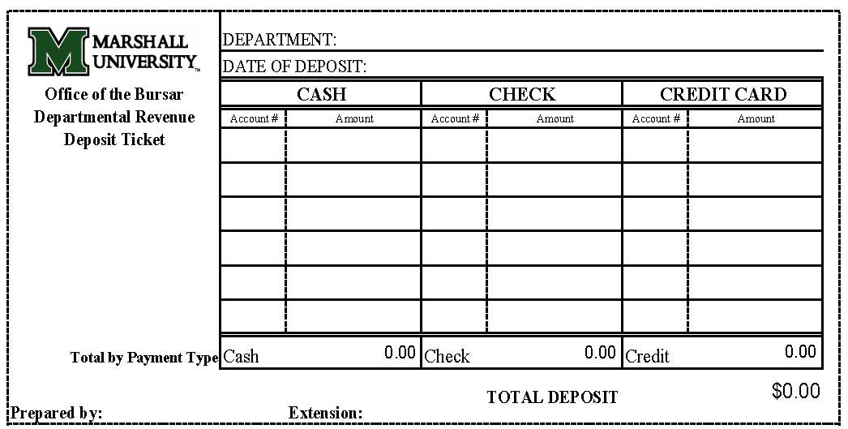
Attachment C
Record should contain the following:
  Name of person or entity
  Amount collected
  Date of collection
  Amount of cash/check/credit card
  Employee (Name and Phone #) who prepared the deposit ticket

Slide 14
Counter/In Person Revenue
All receipt numbers must be tracked and accounted for within the Departmental Unit.
If error occurs with a receipt, void and issue another one.
  Write “void” across face of receipt
  DO NOT discard any voided receipts
  Any missing receipts should be investigated and an explanation clearly documented

Slide 15
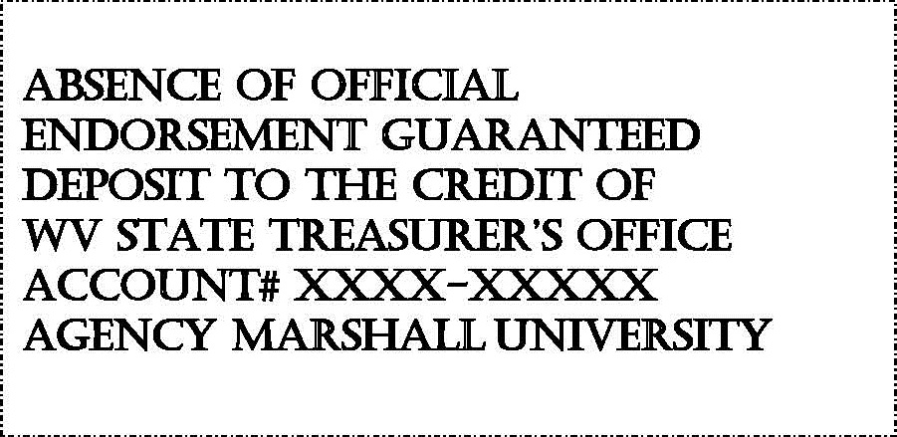
Mail
All mail should be opened with two individuals present. The individual accepting revenue should NOT reconcile funds or prepare deposit.
All checks must have a restrictive endorsement “for deposit only” immediately at time of receipt (Image below).
Documents enclosed with mail payments should be date stamped by one of the employees opening mail.

Slide 16
Mail
All cash and checks received via mail should be entered on the Departmental Revenue Mail Log (Attachment E, next slide). The cash, checks, and log should be forwarded to the person responsible for reconciliation of daily mail revenue and preparation of the Departmental Revenue Deposit Ticket.
The responsible person will verify the total cash and checks match the Departmental Revenue Mail Log and prepare the Departmental Revenue Deposit Ticket.
The bag holding the revenue including the Departmental Revenue Deposit Ticket and Departmental Revenue Mail Log should be sealed and/or locked before it leaves the Departmental Units location. Deposits are to be submitted to the Office of the Bursar.

Slide 17
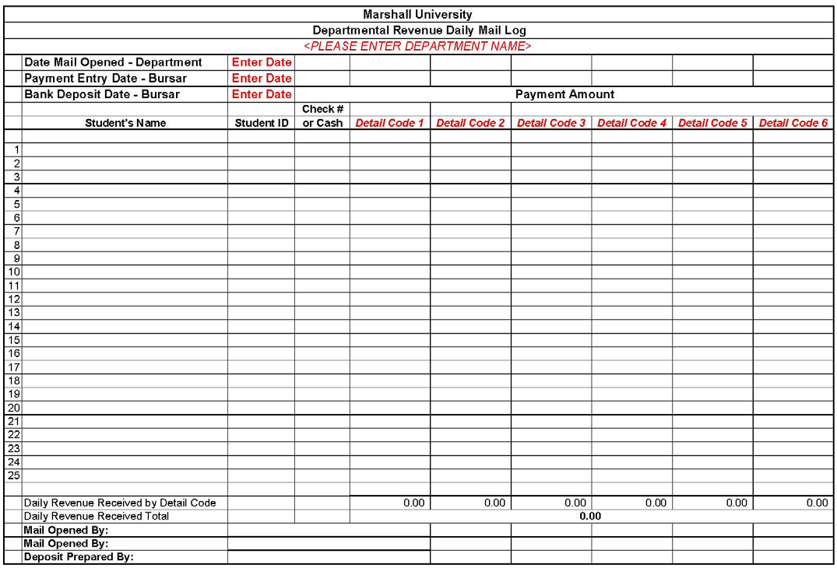
Attachment E

Slide 18
Deposits
WV Code 12-2-2 requires that all revenue collections must be deposited within twenty-four
(24) business hours, regardless of amount receipted.
Make deposits at the Cashier windows, 101 Old Main. Sending deposits through campus mail is not recommended.
Revenue collection may be received at approved temporary locations.

Slide 19
Refunds
The responsible person will send all approved refund requests via email to the Office of the Bursar, with the responsible person’s supervisor copied on the email to refunds@marshall.edu.
Email will include:
  Individual/Company to be refunded
  Date of original payment
  Detail code(s) that payment was deposited to
  ID number
  Address
  Amount to be refunded
Refunds should never be issued by the Department from revenue receipted.

Slide 20
Outside Bank Accounts
No external bank accounts using the name and FEIN number of Marshall University can be created without the approval of the Chief Financial Officer.
Documentation required to open an outside bank account will be completed and submitted to the WVSTO by the Office of the Bursar only. Please contact Alice Roberts for additional information.
WV State Treasurer’s Offices places final approval and monitors accounts as set forth in WV Code 12-2-3.

Slide 21
General Requirements
Under no circumstances should an employee co-mingle Departmental received funds with his/her own personal funds, deposit the received funds in a personal bank account, or take the received funds home for safekeeping.

Slide 22
Imprest Funds
Cash receipts must not be used to establish an imprest fund or petty cash fund. Expenditures or refunds cannot be made from Cash receipts.
Documentation to open, close, and/or change the name of the person responsible for an imprest fund must be submitted to the Office of the Bursar for approval. The office of the Bursar will file all required forms with the WVSTO.
The WV State Treasurer’s Office places final approval on imprest fund rule requirements and conducts applicable surprise audits to departments authorized to maintain an imprest fund.

Slide 23
Check/Money Order Items
Account holder’s name, address, and telephone number must be included on the check.
A bank name must be listed, and the routing number and customer’s bank account number are to be encoded on the bottom edge of the check.
Do NOT accept post-dated or stale dated checks.
  Post-dated checks have a date in the future
  Stale dated checks have a date of six months ago or longer
Do NOT agree to hold check for future deposit.
The numeric amount on the check must match the amount written in words. The bank will default to the amount written in words.
The check must be U.S. funds, signed, and made payable to Marshall University.

Slide 24

Identifying Funny Money
Purchase counterfeit detection pens and follow instructions.
Use the Feel, Tilt, Light method:
  Feel the paper for raised printing,
  Tilt the bill to view color-shifting and
  Hold bill to light to view image and watermark.
Serial Numbers and font on bill should correspond to one another.
Train employees to scrutinize every transaction.
Hand over suspect counterfeit money to your supervisor immediately.
If a counterfeit banknote is received, limit touching the
bill, place in clear plastic bag or envelope, write down the origin and notify the Office of the Bursar and MUPD.
Do not include counterfeit money in daily deposit.
Office of the Bursar

Slide 25
Credit Cards or ACH
Getting started
Valid types of payment
Card present vs Card not present
Refunds vs Voids
Disputes
Sensitive information
ACH payment are electronic payments that have been directly deposited from customer’s account.
Contact Alice Roberts or Matthew Walker if a vendor is asking to process their payment as ACH
Notes:
Before any department is able to accept any type of card payment they must contact the Office of the Bursar who will file and retain all paperwork with the WVSTO. Until this is completed a department cannot purchase any equipement needed to process transactions
Marshall University is currently setup to accept VISA, MasterCard, Discover, AMEX as well as Apple and Google pay.
A card present transaction is one that the customer is on-site making payment. A card-not-present is one that is taken over the telephone.
All refunds need to be emailed to the Office of the Bursar with the Cardholder’s name, date of original transaction, address and amount to be refunded. A void can be done for same day transactions only.
Disputed payments will be processed by the Office of the Bursar but the department has the responsibility in order to receipt re-payment.
Under no circumstances should a department/employee retain a cardholder’s information.

Slide 26
Review & Assistance
Any Departmental unit requiring assistance should contact Marshall University’s Office of the Bursar.
  101 Old Main, Huntington, WV 25755
    304/696-6620
  Matthew Walker, Accountant Senior
    walkerma@marshall.edu
  Scott Rhudy, Supervisor, Student Accounting Services
    rhudy2@marshall.edu
All areas are subject to periodic Internal Audit to determine adherence to University and State policies and procedures.

